Slide 1
States of Consciousness
Chapter 4

Slide 2
Agenda
Exam discussion
Consciousness
Sleep
Substance Use

Slide 3
Consciousness
Consciousness- our awareness of internal and external stimuli
Biological rhythms- internal rhythms of biological activity
Circadian rhythms- biological rhythms that take place over a period of 24 hours
  Ex: temperature, blood sugar, and sleep/ wake cycles
Homeostasis- tendency (and need) to maintain balance
Circadian rhythms are often driven by hormones, such as melatonin influencing sleep regulation

Slide 4

Sleep

Slide 5
Are you getting enough sleep?
Age | Recommended | May Be Appropriate | Not Recommended
0–3 months | 14–17 hours | 11–13 hours 18–19 hours | Fewer than 11 hours More than 19 hours
4–11 months | 12–15 hours | 10–11 hours 16–18 hours | Fewer than 10 hours More than 18 hours
1–2 years | 11–14 hours | 9–10 hours 15–16 hours | Fewer than 9 hours More than 16 hours
3–5 years | 10–13 hours | 8–9 hours 14 hours | Fewer than 8 hours More than 14 hours
6–13 years | 9–11 hours | 7–8 hours 12 hours | Fewer than 7 hours More than 12 hours
14–17 years | 8–10 hours | 7 hours 11 hours | Fewer than 7 hours More than 11 hours
18–25 years | 7–9 hours | 6 hours 10–11 hours | Fewer than 6 hours More than 11 hours
26–64 years | 7–9 hours | 6 hours 10 hours | Fewer than 6 hours More than 10 hours
≥65 years | 7–8 hours | 5–6 hours 9 hours | Fewer than 5 hours More than 9 hours

Slide 6
What can cause an unhealthy sleep schedule?
Job/
School/
Responsibilities
Health Conditions
Sleep Debt

Slide 7
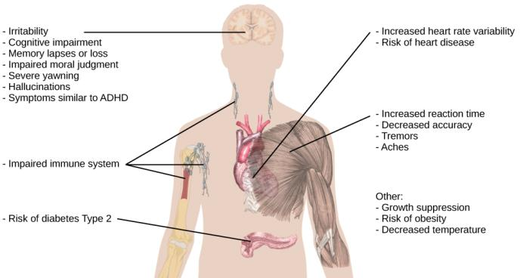
Ramifications of Poor Sleep

Slide 8
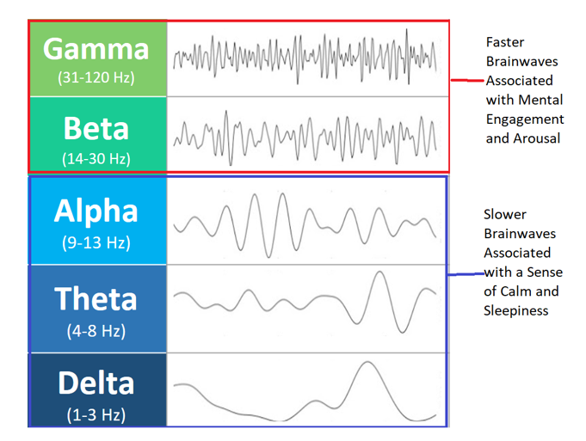
Types of Brain Waves
Amplitude: the height of a wave; determines loudness
Frequency: the distance between waves; determines pitch

Slide 9
Stages of Sleep
Stage | Description | Wave Type
Awake | Responding to stimuli | Beta or gamma waves
NREM Sleep Stage 1 | Drifting to sleep; slow decrease in functions like heart rate and breathing; easy to wake from | Alpha then theta waves
NREM Sleep Stage 2 | Deep relaxation; will see sleep spindles and K-complexes | Theta waves
NREM Sleep Stage 3 | Deep sleep; difficult to wake from | Delta waves
REM Sleep | When dreaming occurs; active waves but muscle paralysis; important for memory and emotion processing | Variety
Rapid Eye Movement (REM): when your eyes are darting about despite your eyelids being closed
Sleep is divided into REM sleep and non-REM (NREM) sleep

Slide 10
Historic Theories on Dreams
Sigmund Freud: manifest content vs latent content
Carl Jung: the collective unconscious
Rosalind Cartwright: reflection of important life events
Alan Hobson: activation-synthesis theory of dreaming and lucid dreams

Slide 11
Disorders that Impact Sleep
Insomnia
Parasomnias
  Sleepwalking (somnambulism), REM sleep behavior disorder, restless leg syndrome, night terrors
Sleep apnea
Sudden infant death syndrome (SIDS)
Narcolepsy
Substance use disorders

Slide 12

Substance Use

Slide 13
Substance Use Disorders
In substance use disorders, there is a compulsive pattern of drug use (prescription and non-prescription) that is often associated with physical and psychological dependence
Physical dependence: changes in bodily functions that can cause withdrawal symptoms upon cessation of use
Psychological dependence: user is emotionally reliant on drug, and stopping may cause severe psychological distress
Withdrawal: experiencing a variety of symptoms (ranging from agitation to possible death) when a person stops using a drug
Tolerance: when a person needs more of a drug to receive the desired effect due to extended use
IMPORTANT: If you or a loved one are seeking to stop using a drug (prescribed or not), PLEASE seek medical assistance. It is illegal for doctors to report drug use to police, so you will get help, not arrested.

Slide 14
Psychologically Addictive Drugs
Class of Drug | Effects on Body | Effects When Used | Examples
Stimulants | Increased heart rate, blood pressure, body temperature | Alertness, euphoria, agitation, paranoia, death | Cocaine, amphetamines (ex: Adderall), caffeine, methamphetamines (ex: Ecstasy)
Depressants | Decreased heart rate & blood pressure | relaxation, decreased inhibitions; sleep, motor disturbance, memory loss, decreased respiratory function, death | Alcohol, barbiturates, Benzodiazepines (ex: Xanax)
Opiates | Decreased pain, pupil dilation, decreased gut motility, decreased respiratory function | Pain relief, euphoria, sleepiness, decreased respiratory function, death | Opium, Heroin, Fentanyl, Morphine, Oxycodone, Vicoden, methadone, and other prescription pain relievers
Hallucinogens | Increased heart rate & blood pressure | Mild to intense perceptual changes; physical reactions to mental experiences, death | Marijuana, LSD, ketamine, and PCP

Slide 15
Other States of Consciousness
Hypnosis: a state of extreme self-focus and attention in which minimal attention is given to external stimuli
Meditation: the act of focusing on a single target to increase awareness of the moment
Fun fact: there have been studies that show some people can undergo surgeries while in a hypnotized state, and they report no more pain than someone who received medication for the surgery. We don’t know why this was possible, just that it does work for some people.

Slide 16
Next Time on PSY 203…
Before Next Class:
Next Class:
Read Chapter 5
Complete Chapter 5 Quiz
  Due 2/17 at 2 pm
Submit Exam Reflection
  Due 2/17 at 11:59 pm
Potentially: Email Dr. S to make up exam points
Chapter 5 – Sensation & Perception

